Slide 1
Medical Insurance Cost Analysis with Power BI A Behavioral and Demographic Exploration of Health Charges
Jing You | Data Analytics Portfolio
April 2025

Slide 2
Project Background & Objective
Medical expenses are a core focus in the health insurance industry.
This project aims to analyze how behavioral (e.g., smoking) and demographic (e.g., age, sex, region) factors affect individual medical charges.
Built with Power BI, the dashboard provides dynamic, interactive insights.

Slide 3
Dataset Overview
Source: Kaggle – Insurance Cost Dataset
Records: 1,338 observations
Key fields:
age: Age of the policyholder
sex: Gender
bmi: Body Mass Index
children: Number of dependents
smoker: Smoking status
region: U.S. region
charges: Annual medical charges (target variable)

Slide 4
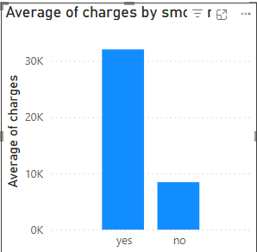
Impact of Smoking on Medical Charges
Smokers pay on average over $30,000, while non-smokers pay less than $10,000. Smoking is the most influential behavioral factor in medical cost. Suggestion: Insurance pricing models should account for smoking status.

Slide 5
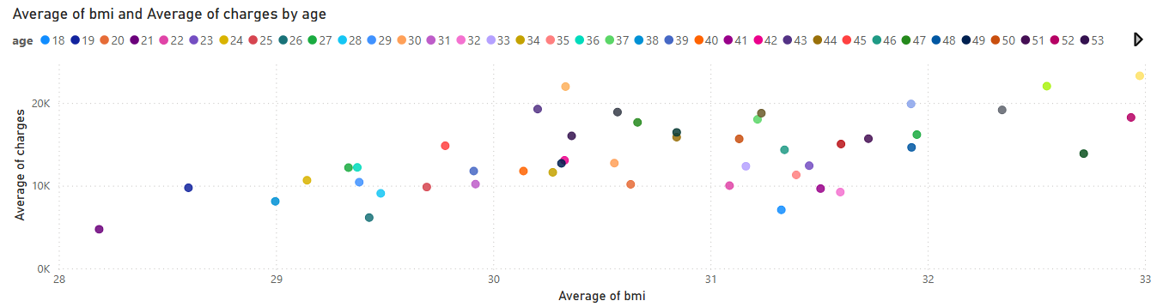
BMI and Medical Cost by Age
Positive correlation: Higher BMI is associated with higher medical expenses.Charges increase significantly after BMI > 30 (obesity threshold).Color-coded by age: Older individuals with the same BMI tend to have higher costs.

Slide 6

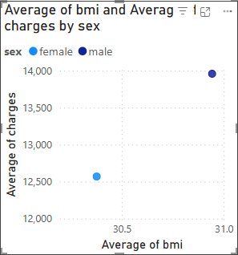
Gender Differences in Cost and BMI
Notes:
Average male BMI: ~31, Average female BMI: ~30.5
Average charges for males are higher (~$14,000 vs ~$12,500)
Indicates men may represent a higher health risk cost-wise.

Slide 7
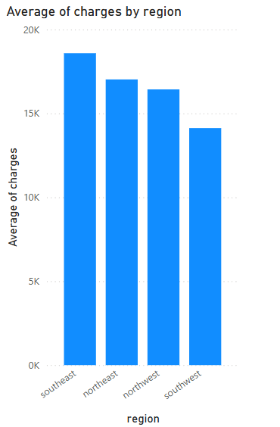
Average Charges by Region
Notes:
Southeast has the highest average medical charges.
Northeast follows closely.
Possible causes: lifestyle, income, healthcare access, or smoking rates.

Slide 8

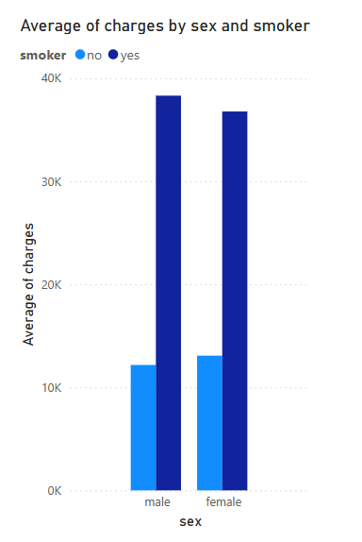
Charge Comparison by Gender and Smoking Status
Notes:
Male smokers are the most expensive group.
Female non-smokers have the lowest charges.
Combination analysis helps in identifying high-risk populations.

Slide 9
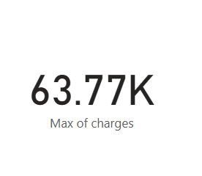
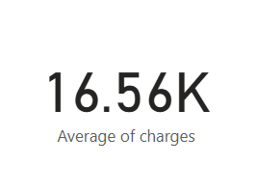
Key Insights & KPIs
Maximum charge: $63,770
Average charge: $13,270
Slicers allow dynamic filtering by age, sex, smoker status, and region
Great for quick business insight snapshots

Slide 10
Conclusion & Next Steps
Smoking and BMI are the most significant predictors of high medical charges.
Regional and gender differences also contribute to cost variations.
Non-smokers and individuals with lower BMI tend to have significantly lower medical expenses
.
The Southeast region exhibits the highest average charges, possibly due to behavioral or demographic patterns.

Slide 11
THANK YOU
Jing You
jingliuyou@gmail.com

